Slide 1
Meeting with Spanish teachers
IIS Leonardo da Vinci- Firenze (IT)
April 05th 2022
Participants: Spanish teachers
7 participants
BiMo - Bilingualism in Monolingual Contexts
2020-1-ES01-KA201-081917
Erasmus+ Programme - Strategic Partnerships for School Education
Project: BiMo
Project No. ES01-KA201-081917

Slide 2
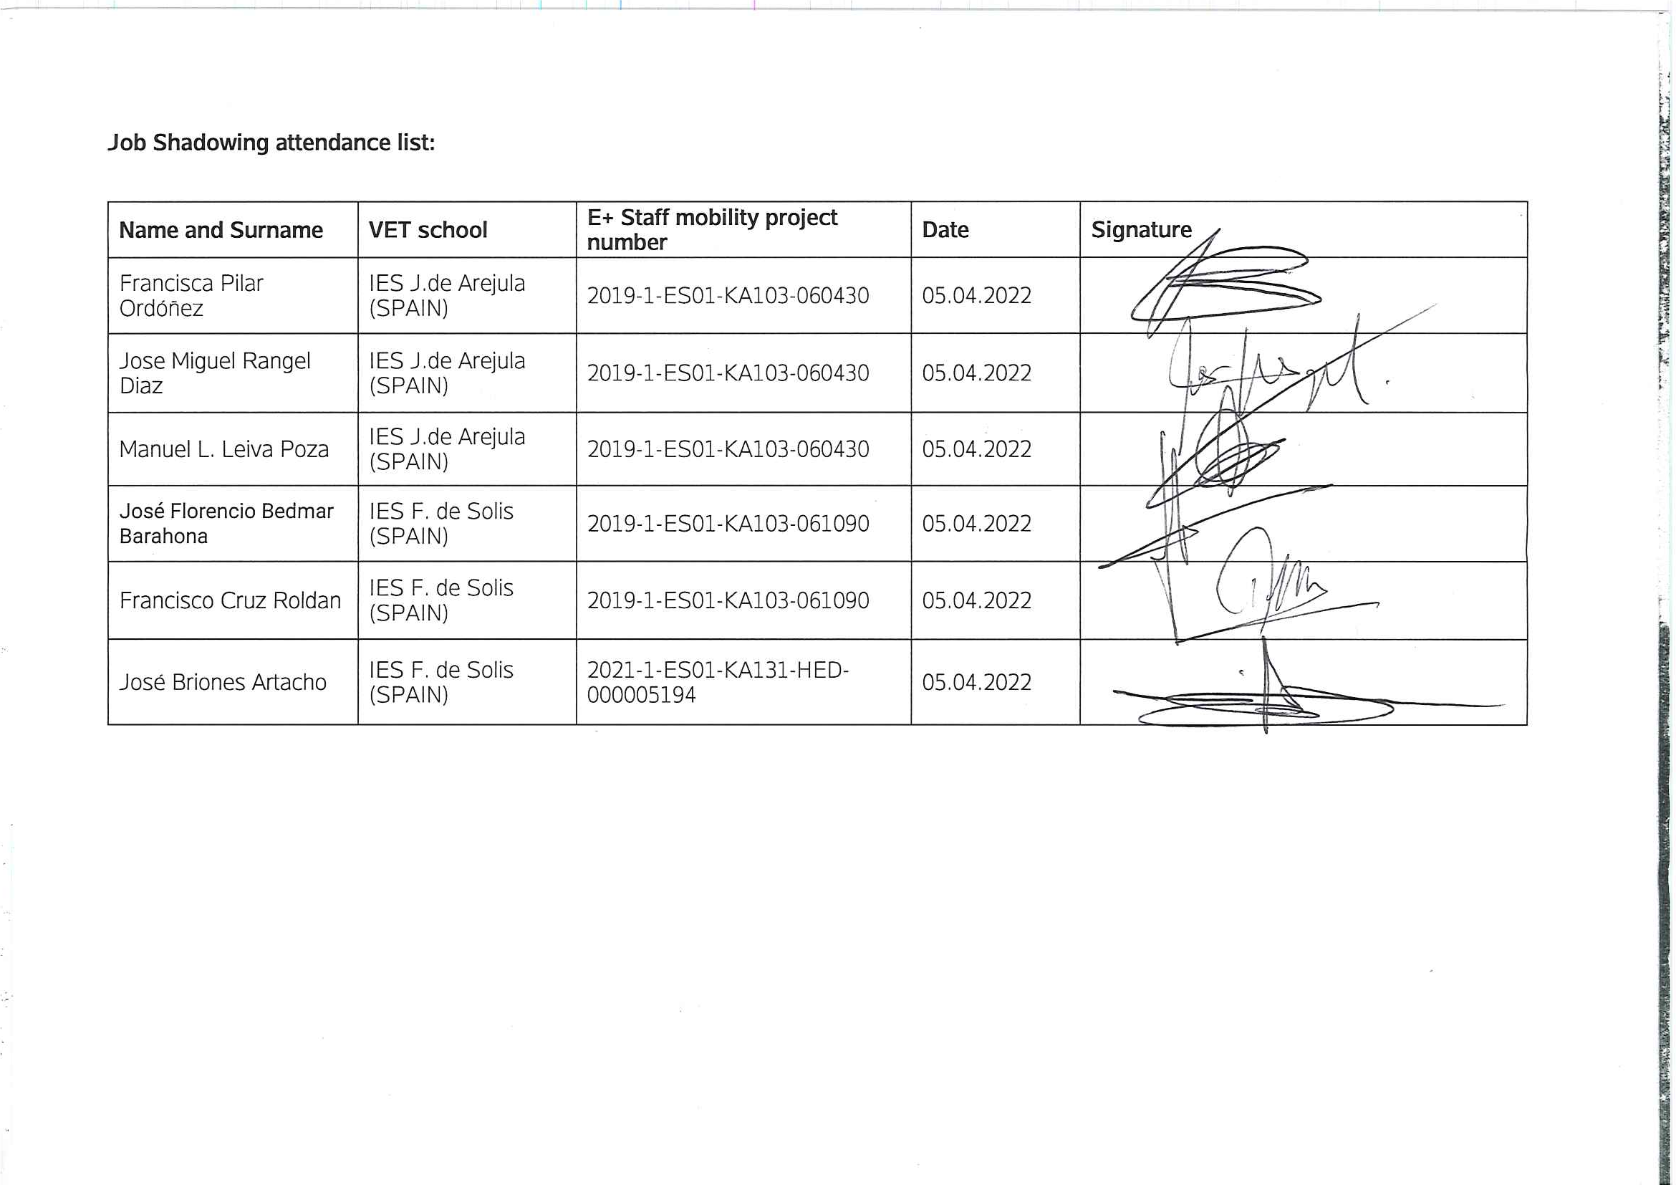
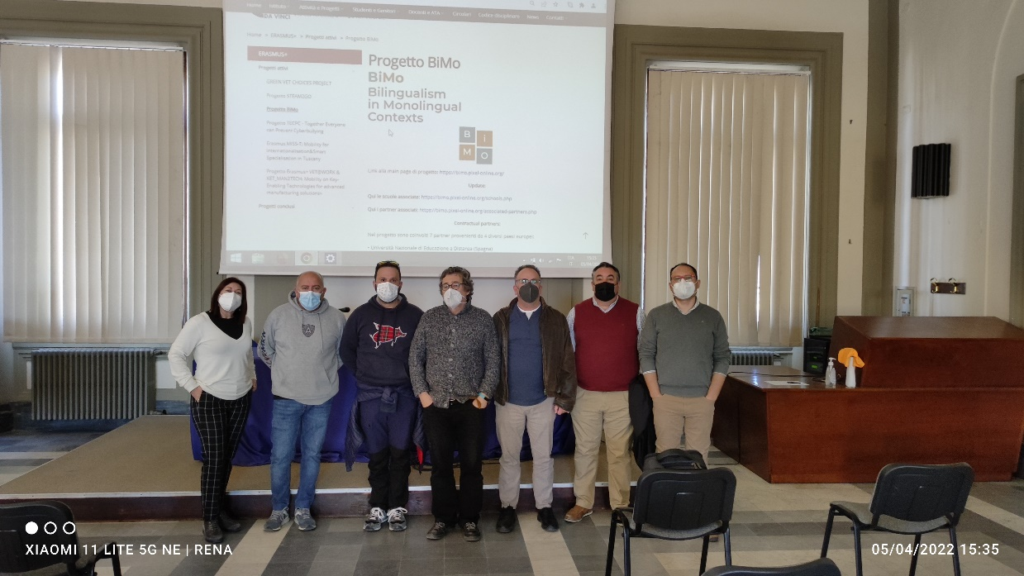
BiMo - Bilingualism in Monolingual Contexts
2020-1-ES01-KA201-081917
Erasmus+ Programme - Strategic Partnerships for School Education
Project: BiMo
Project No. ES01-KA201-081917

